Slide 1
Spares Planning
Adam Rousseau-Norton

Slide 2
The Project
What, Who and Why?
Condair
Demo
Adam Rousseau-Norton

Slide 3
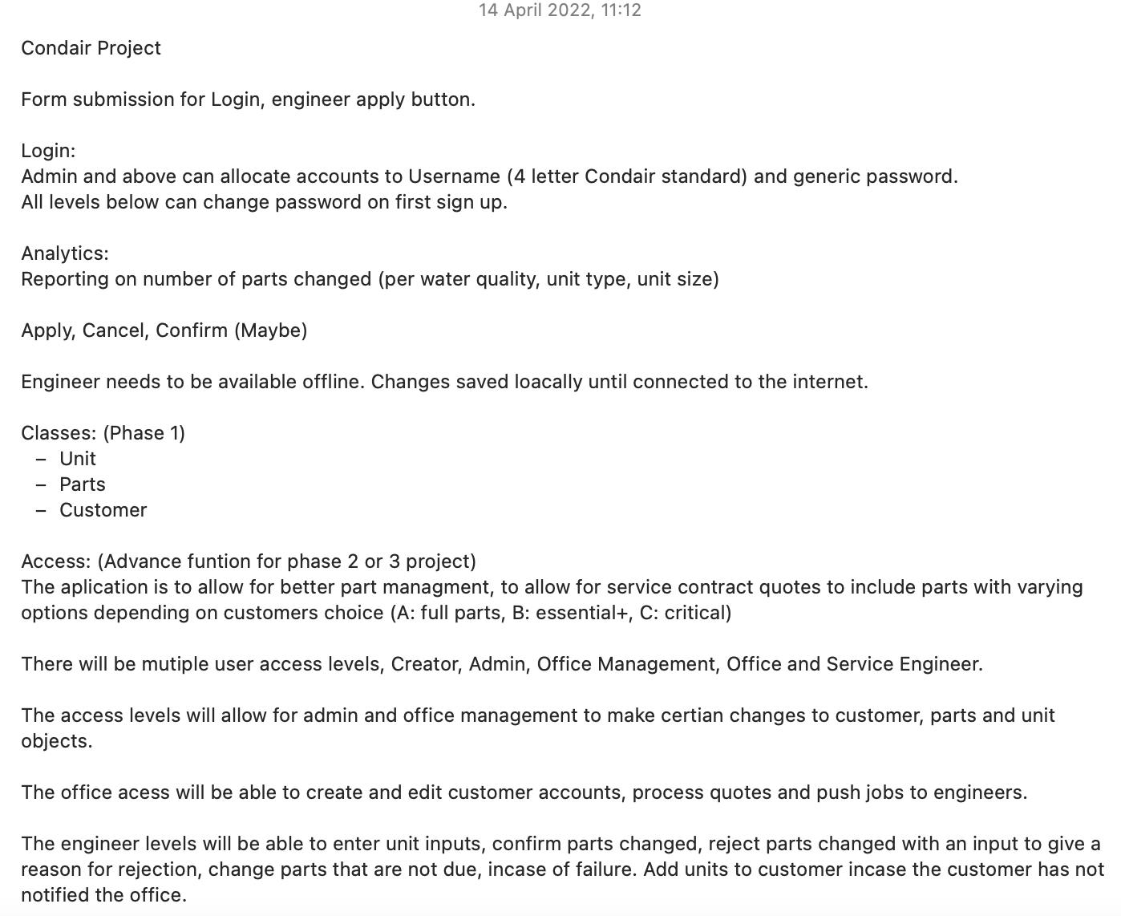
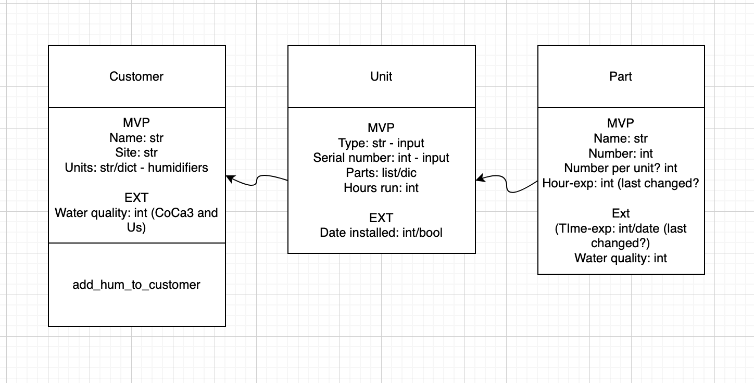
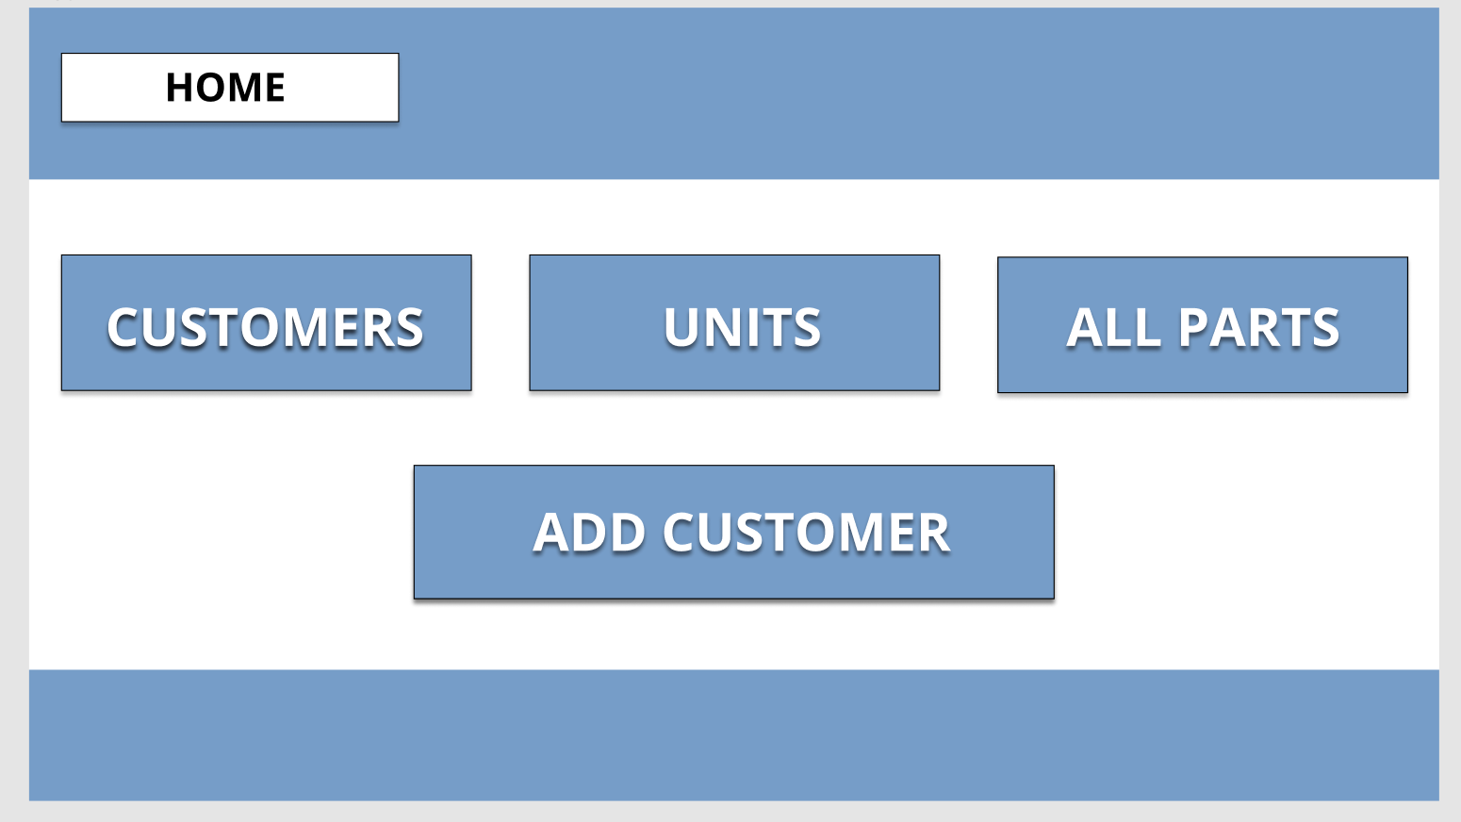
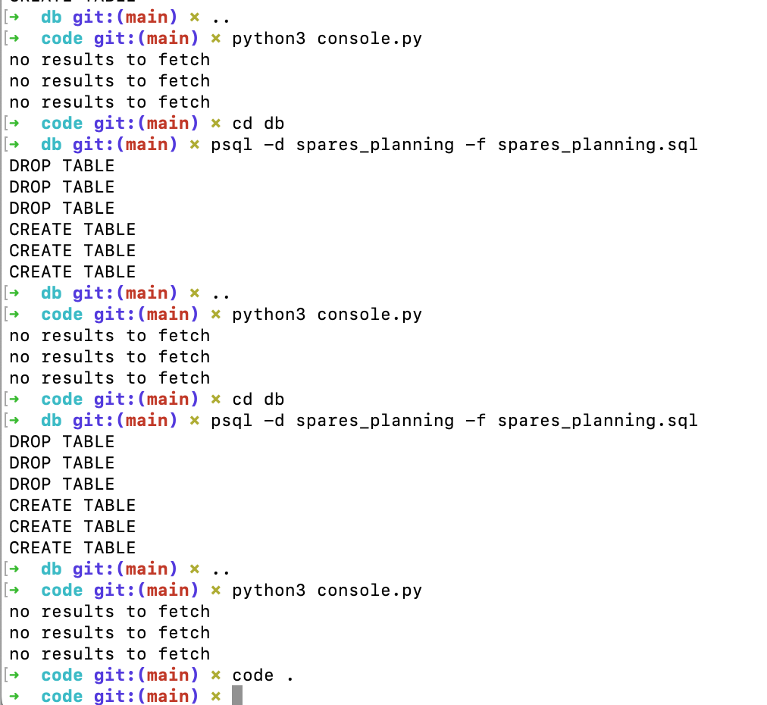
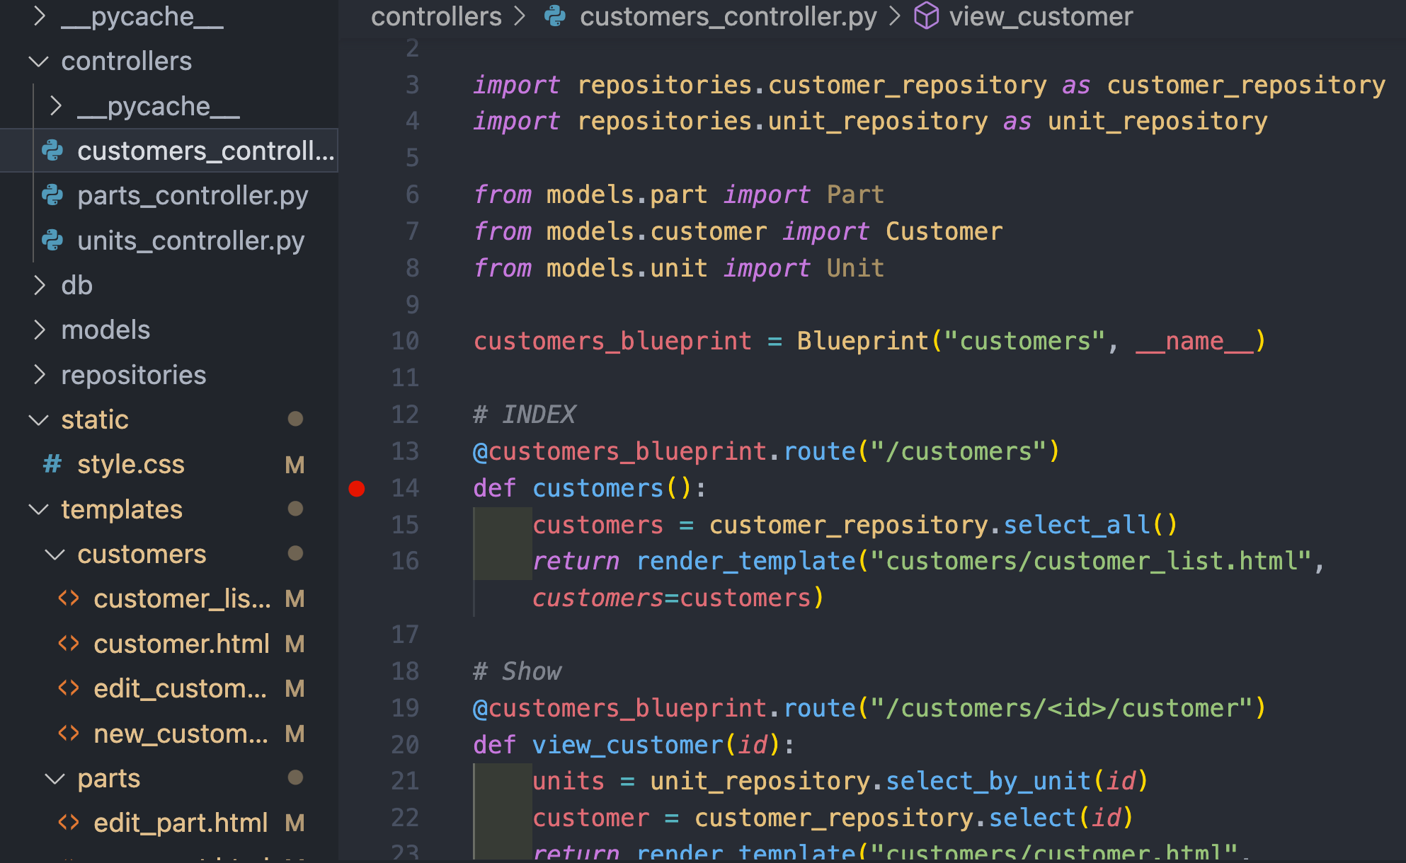


The Process
Planning
Make it
Lessons learned
Adam Rousseau-Norton

Slide 4

Aspirations for App
Functioning Concept
Free trail
Sign contract
Adam Rousseau-Norton

Slide 5
Thank you
Any questions?

